Slide 1




Differentially Private Online Task Assignment in Spatial Crowdsourcing: A Tree-based Approach
Qian Tao ¹, Yongxin Tong ¹, Zimu Zhou²,
Yexuan Shi ¹, Lei Chen³, Ke Xu¹
Notes:
Hello everyone, im qian tao from beihang university.
Today I will introduce my work named differentially private online task assignment in spatial crowdsourcing: a tree-based approach.
This is a collaborative work by qian tao, yongxin tong, yexuan shi and ke xu from Beihang university
,zimu zhou from eth Zurich, and lei chen from hong kong university of science and technology.

Slide 2
Outline
Background and Motivation
Problem Definition
A Tree-based Framework
Random Walk Acceleration
Experimental Evaluation
Conclusions
Notes:
Today my presentation includes these six parts.
First I will introduce the background and motivation of my work

Slide 3









Background
Spatial Crowdsourcing has penetrated in our life
Taxi Calling
Food Delivery
Logistics
Notes:
With the development of the mobile devices, spatial crowdsourcing has penetrated in our life,
Like uber and didi in taxi calling, grubhub and yelp in food delivery, and ups and fedex in logistics

Slide 4

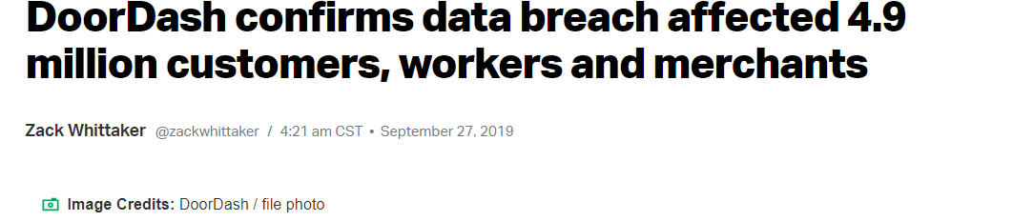

Background
Spatial Crowdsourcing has penetrated in our life
Privacy leakage draws attraction in recent years
Taxi Calling
Food Delivery
Logistics
Notes:
On the other hand, these applications facet the risk of privacy leakage and draw more and more attention in recent years
For example, uber, doordash, and ups have met the data breaches.

Slide 5
Background
A core operation of spatial crowdsourcing is task assignment.
Type | Applications | Issue
Taxi Calling |  | Assign taxi-calling orders to drivers
Food Delivery |  | Assign food orders to proper deliverers
Logistics |  | Assign delivery tasks to proper workers
Notes:
A core operation of spatial crowdsourcing is task assignment.
In taxicalling platforms, the server should assign taxicalling orders to proper drivers.
Food delivery and Logistics also need assign the tasks to proper workers.

Slide 6


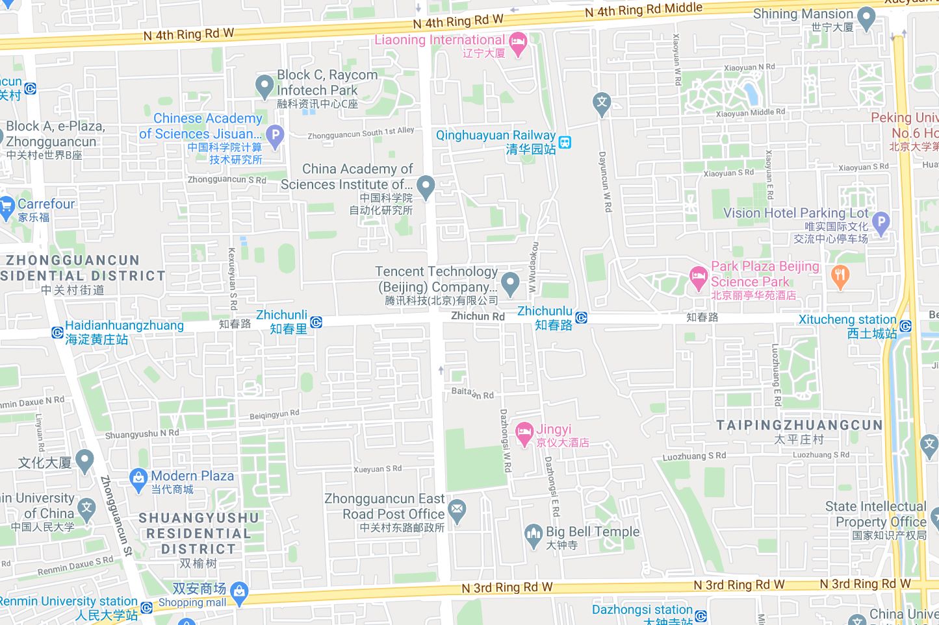










Background
$$w_{3}$$
$$w_{2}$$
$$t_{3}$$
$$t_{2}$$
$$w_{1}$$
$$t_{1}$$
Notes:
Take taxi calling as a example.
Suppose we have three customers and drivers on the map.
Blue arrows in the figure are a possible task assignment.

Slide 7
Background
How to make effective task assignment while protecting the location privacy of the tasks and workers?
$$w_{3}$$
Effective task
assignment
$$w_{2}$$
$$t_{3}$$
$$t_{2}$$
Location protection
from server
$$w_{1}$$
$$t_{1}$$
Notes:
However, if we assign t1 to w1, t2 to w2, and t3 to w3, the drivers will travel a less unoccupied distance, and be more effective.
From the perspect of the customers and drivers, they may require their locations cannot be distinguished by the platform.
Hence a problem is : how to …

Slide 8
Limitations of Existing Works
Ignore a widely-researched and practical objective: minimizing total distance
Lack of theoretical analysis of the effectiveness of the task assignment
H. To et al, Privacy-preserving online task assignment in spatial crowdsourcing with untrusted server. In ICDE 2018.
L. Wang et al, Location privacy-preserving task allocation for mobile crowdsensing with differential geo-obfuscation. In WWW 2017.
Notes:
Existing solutions cannot handle the minimizing total distance objective,
And lack of theoretical analysis of the effectiveness of the assignment

Slide 9
Contributions
Devise a novel tree-based framework for private online task assignment
Design a privacy mechanism to protect location privacy
analyze the effectiveness of the framework
Propose a random walk method for acceleration
Notes:
In summary, our work contains the following four contributions:
We …

Slide 10
Outline
Background and Motivation
Problem Definition
A Tree-based Framework
Random Walk Acceleration
Experimental Evaluation
Conclusions
Notes:
Next I will introduce the problem definition of this work

Slide 11
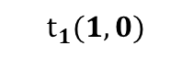
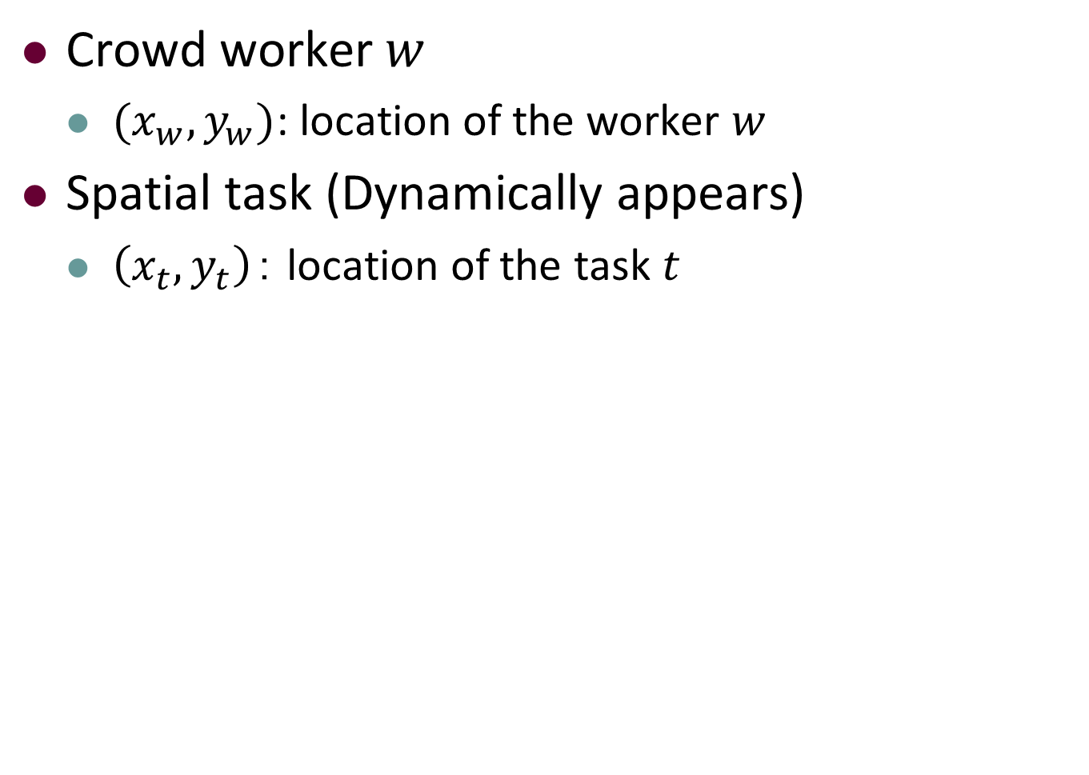
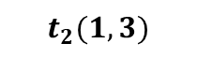
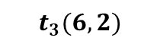



Problem Definition
Crowd worker $w$
$(x_{w},y_{w})$: location of the worker $w$
Spatial task (Dynamically appears)
$\left(x_{t},y_{t}\right)$： location of the task $t$
Y
6
$$w_{3}(5,5)$$
5
4
$$t_{2}(1,3)$$
3
$$w_{1}(2,3)$$
2
$$w_{2}(2,2)$$
$$t_{3}(6,2)$$
1
$$t_{1}(1,0)$$
0
1
2
3
4
5
6
7
X
Notes:
Formally, a crowd worker w has a loation (xw,yw) representing her current location
A dynamically appearing spatial task t is associated with a task location (xt,yt)

Slide 12
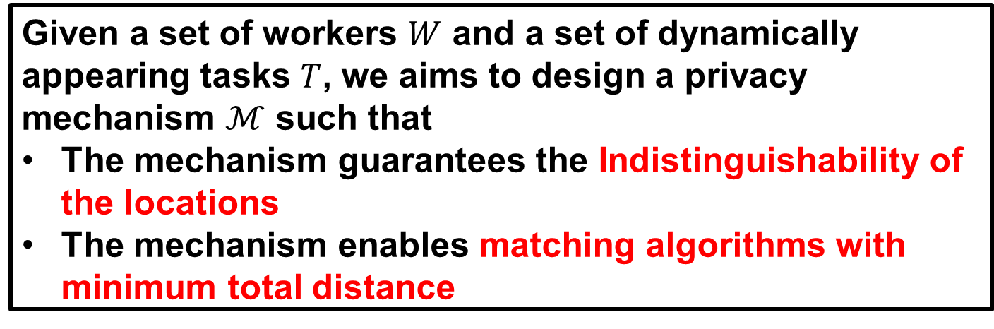
Problem Definition
The Privacy-preserving Online Minimum Bipartite Matching Problem is as follows.
POMBM Problem
Given a set of workers $W$ and a set of dynamically appearing tasks $T$, we aims to design a privacy mechanism $ℳ$ such that
The mechanism guarantees the Indistinguishability of the locations
The mechanism enables matching algorithms with minimum total distance
Make effective
task assignment
Location Protection
from server
Notes:
And we aim at finding a privacy mechanism satisfying the following two objectives:
From the perspective of privacy preservation, we want a mechanism guarantees the locations indistinguishable

Slide 13
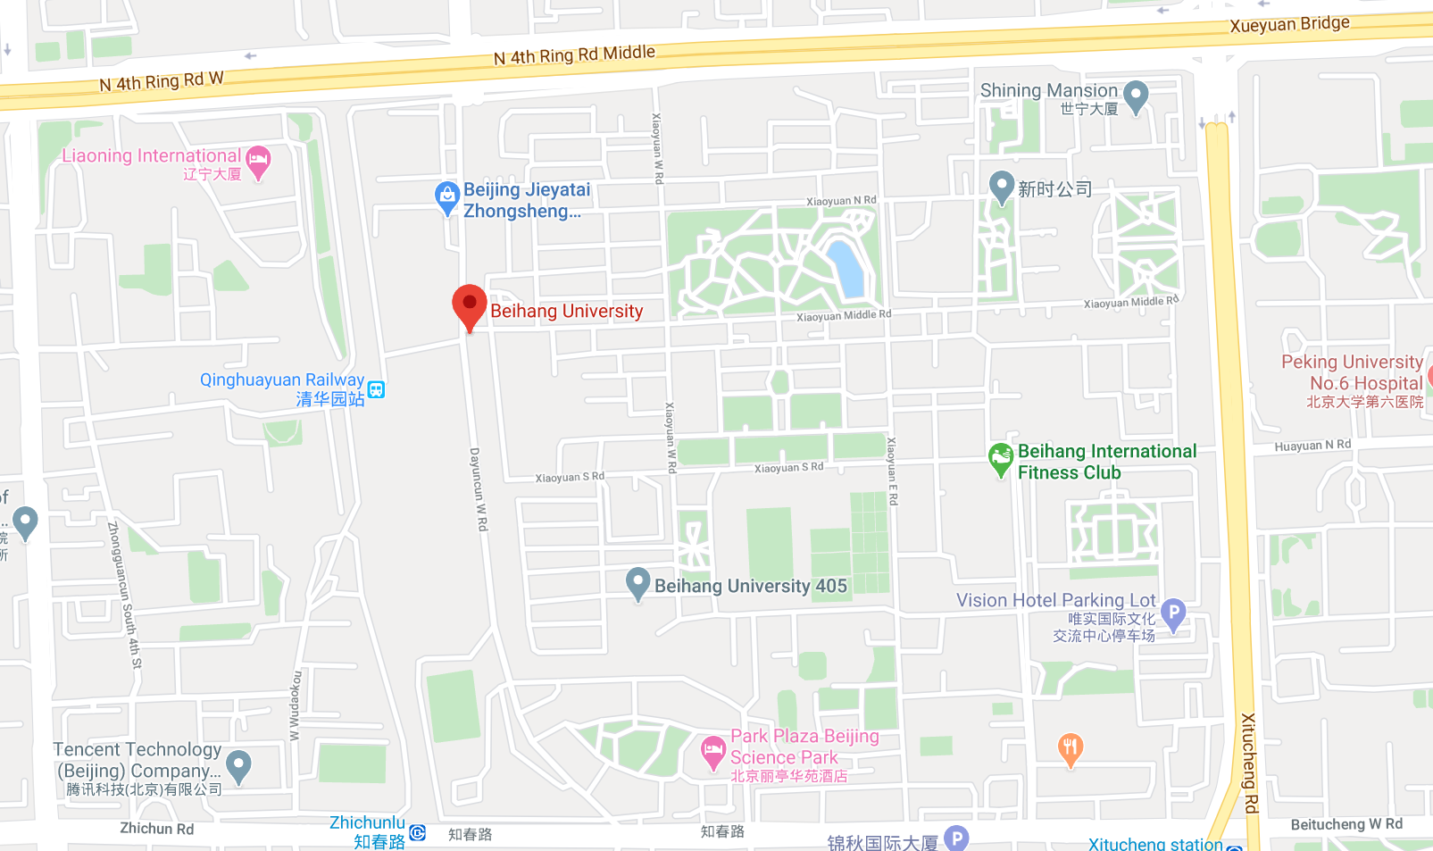

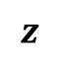
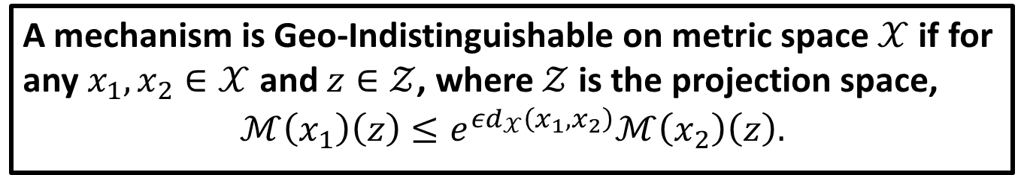
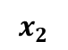
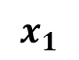
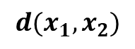


Problem Definition: Indistinguishability
We require a mechanism that satisfies Geo-Indistinguishability.
Geo-Indistinguishability
A mechanism is Geo-Indistinguishable on metric space $𝒳$ if for any $x_{1},x_{2}∈𝒳$ and $z∈𝒵$, where $𝒵$ is the projection space,
$$ℳ\left(x_{1}\right)\left(z\right)≤e^{εd_{𝒳}\left(x_{1},x_{2}\right)}ℳ\left(x_{2}\right)\left(z\right).$$
$$x_{1}$$
$x_{1}$ and $x_{2}$ cannot be distin-
guished with high probability
$$z$$
$$d(x_{1},x_{2})$$
$𝓜\left(x\right)\left(z\right)$: Probability of
$x$ projected to point $z$
$$x_{2}$$
Notes:
We require the mechanism satisfies geo-indistinguishability.
Geo-indistinguishability is formally defined as shown.
The Geo-indistinguishability requires that the probability of two nodes x1 and x2 being projected to the same node z cannot exceed a limit, distance power of e.
This definition assures that with high probability two protected points cannot be distinguished

Slide 14

Problem Definition
The Privacy-preserving Online Minimum Bipartite Matching Problem is as follows.
POMBM Problem
Given a set of workers $W$ and a set of dynamically appearing tasks $T$, we aims to design a privacy mechanism $ℳ$ such that
The mechanism guarantees the Indistinguishability of the locations
The mechanism enables matching algorithms with minimum total distance
$$min\sum_{\left(w,t\right)∈M}{dis(w,t)}$$
Make effective
task assignment
Location protection
from server
Notes:
\
From the perspective of effective task assignment, we want our mechanism enables matching algorithms with minimum total distance

Slide 15
Outline
Background and Motivation
Problem Definition
A Tree-based Framework
Random Walk Acceleration
Experimental Evaluation
Conclusions
Notes:
Next I will introduce our tree-based framework

Slide 16
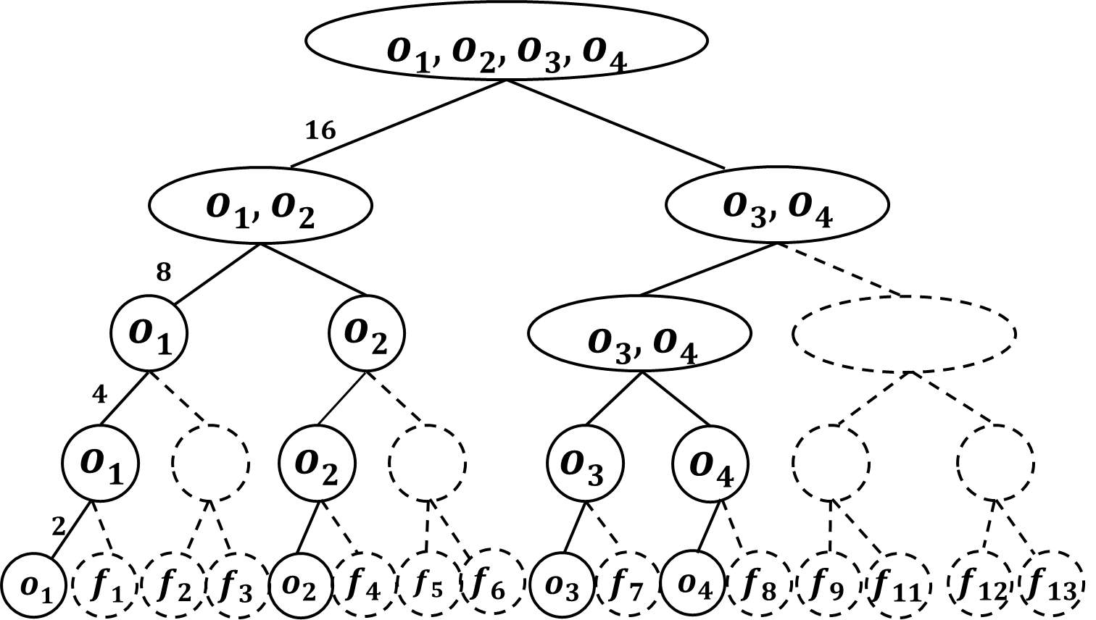





Tree-based Framework
Our solution is devised based on a tree-based framework.
Server
①Construct and publish the HST
②Add noise by our mechanism
③Publish the obfuscated locations
④Assign tasks/workers
①
①
④
④
③
③
②
Task
Worker
②
Perturbed Task
Perturbed
Worker
Notes:
Our tree-based framework includes the following four steps
First the server constructs an hst tree structure and publish the hst to all tasks and workers
Then tasks and workers add noise based on our privacy mechanism and publish their perturbed locations
Finally the server assign tasks to workers based on their obfuscated locations
We will introduce our framework in these four steps

Slide 17
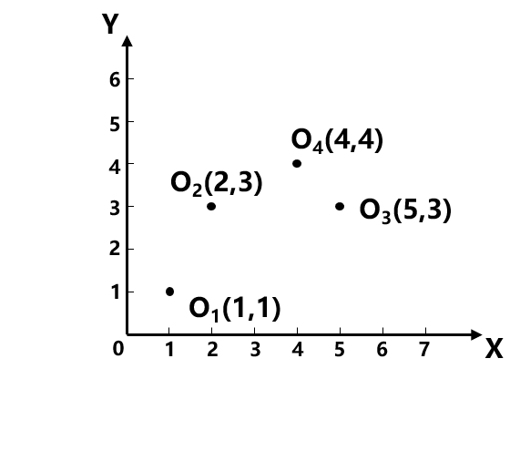
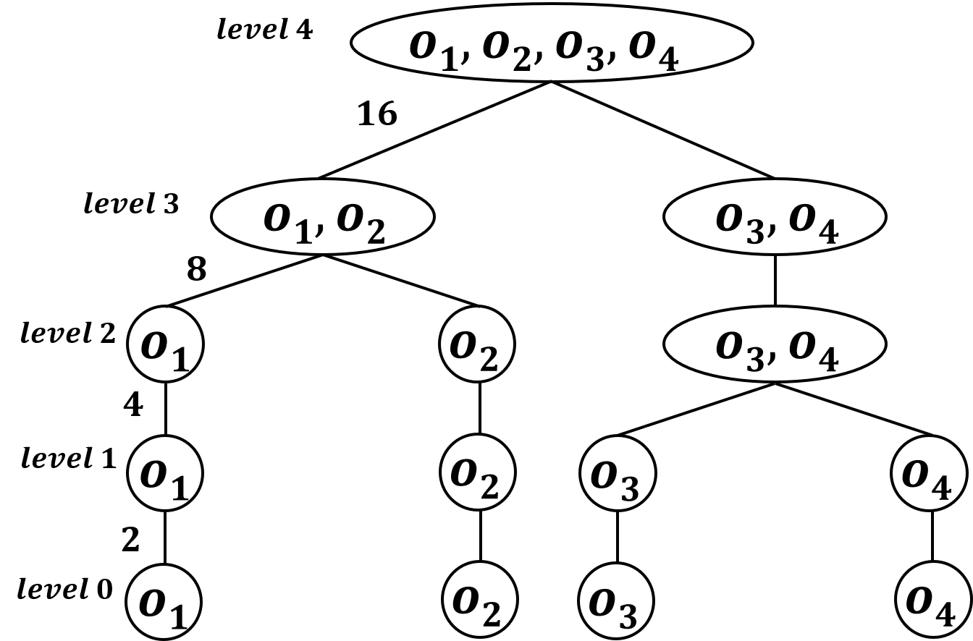
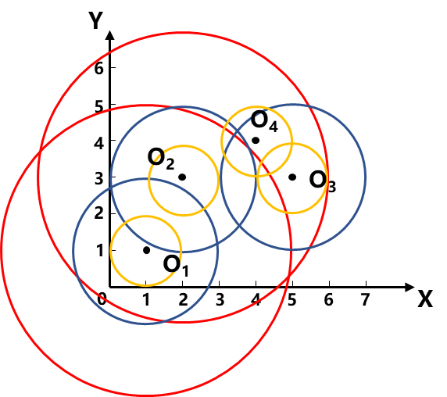
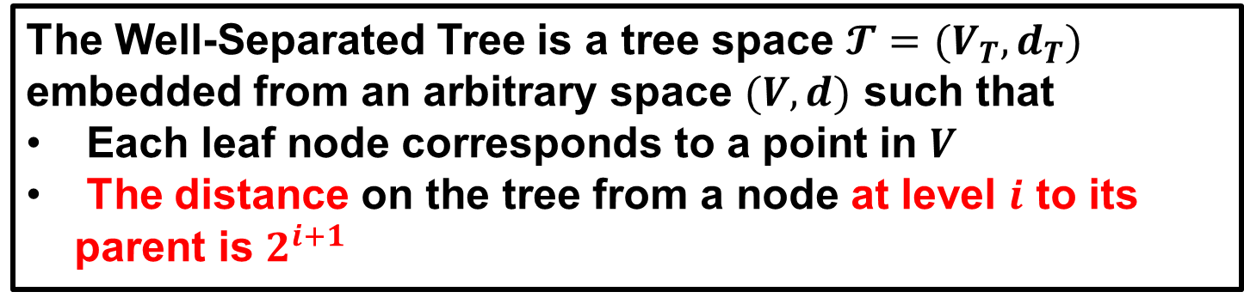
HST Construction
Hierarchical Well-Separated Tree (HST)
The Well-Separated Tree is a tree space $𝓣=(V_{T},d_{T})$ embedded from an arbitrary space $(V,d)$ such that
Each leaf node corresponds to a point in $V$
The distance on the tree from a node at level $i$ to its parent is $2^{i+1}$
Notes:
In the first step, we choose the hierarchical-well-separated tree, because it has been shown powerful to online bipartite matching
The HST is a tree space embedded from an arbitrary space $(V,d)$ such that
Xx
Xx

Slide 18
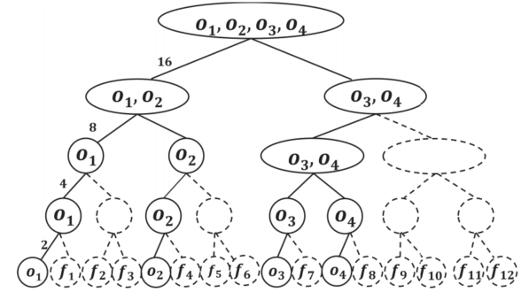
HST Construction
Augment the HST to a complete one by adding fake nodes.
2 branches maximally
The original HST
fake nodes
The complete HST
Notes:
In our framework, to reduce the communication between the server and tasks and workers, the server further augments the hst to a complete one by adding fake nodes
Take the previous hst as an example.
There are at most 2 branches in the original HST, hence we add fake nodes such that each intermediate nodes have exactly 2 children

Slide 19
Tree-based Framework
Our solution is devised based on a tree-based framework.
Server
①Construct and publish the HST
②Add noise by our mechanism
③Publish the obfuscated locations
④Assign tasks/workers
①
①
④
④
③
③
②
Task
Worker
②
Perturbed Task
Perturbed
Worker
Notes:
After the server constructing the complete hst, we then present the privacy mechanism designed for tasks and workers

Slide 20
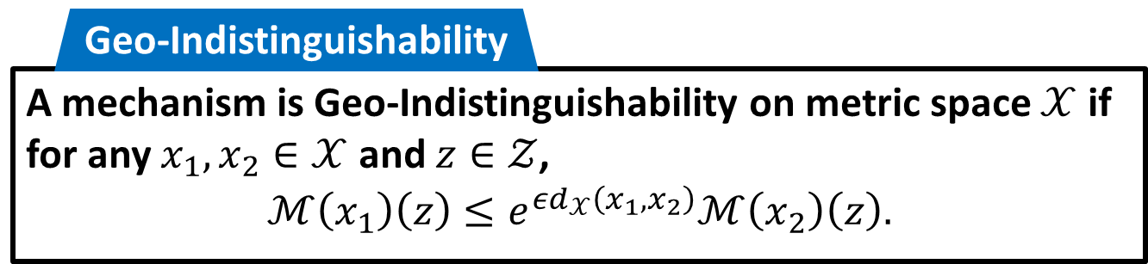
Privacy Mechanism Design
Main Idea: Project the exact location to one of the leaf nodes such that Geo-I is satisfied.
How to determine the probability
that the exact location is projected
to the leaf nodes?
Exact node
Notes:
Our main idea is to project the exact location to one of the leaf nodes such that geo-I is satisfied
For example, if a worker is located at o_1, then it will be projected to one of the leaf nodes, that is o_1-o_4 and f_1 to f_12.
Now the problem is
How to determine the probability of projecting from the exact location to the leaf nodes
Notice that

Slide 21


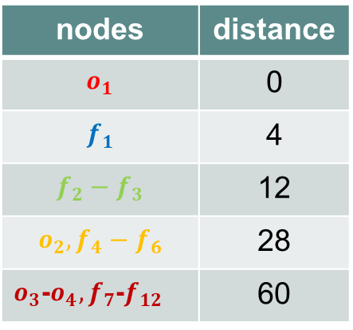
Privacy Mechanism Design
Assign different projection weights to leaf nodes based on the distance to the exact node.
nodes | distance
$$o_{1}$$ | 0
$$f_{1}$$ | 4
$$f_{2}−f_{3}$$ | 12
$$o_{2},f_{4}−f_{6}$$ | 28
$o_{3}$-$o_{4},f_{7}$-$f_{12}$ | 60
Least common
ancestor of $o_{1}$ and $f_{3}$
Observation:
Leaf nodes’ distance to $o_{1}$ depends on
their least common ancestor with $o_{1}$
Notes:
Our solution is to assign different xxx.
Here an observation is that the leaf nodes distance to o_1 depends on their least common ancestor with o_1.
For example, f2 and f3 have the same least common ancestor with o1, and their distance to o_1 are the same.
Back to our example, the distance from o_1 to itself is 0, the distance from f_1 to o_1 is 4, the distance from o_1 to f_2,f_3 is 12.
Similarly we divide the leaf nodes into 5 sets.

Slide 22
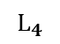
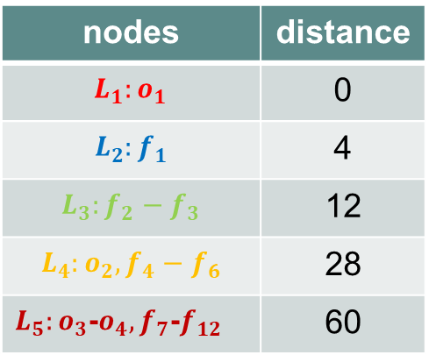
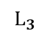

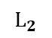
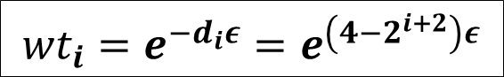
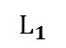
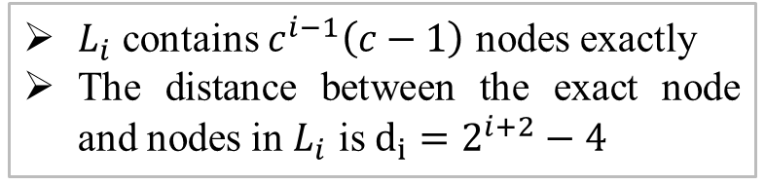

Privacy Mechanism Design
Key Point: Assign different projection weights to leaf nodes based on the distance to the exact node.
nodes | distance
$$L_{1}:o_{1}$$ | 0
$$L_{2}:f_{1}$$ | 4
$$L_{3}:f_{2}−f_{3}$$ | 12
$$L_{4}:o_{2},f_{4}−f_{6}$$ | 28
$L_{5}:o_{3}$-$o_{4},f_{7}$-$f_{12}$ | 60
$${wt}_{i}=e^{−d_{i}ε}=e^{\left(4−2^{i+2}\right)ε}$$
The projection
weight of a node in $L_{i}$
$L_{i}$: the set of leaf nodes whose LCA with the exact node is located at level $i$
$L_{i}$ contains $c^{i−1}\left(c−1\right)$ nodes exactly
The distance between the exact node and nodes in $L_{i}$ is $d_{i}=2^{i+2}−4$
$$L_{1}$$
$$L_{2}$$
$$L_{3}$$
$$L_{4}$$
Notes:
Formally, we define L_i as the set of leaf nodes whose least common ancester with the exact node is located at level i.
L_i have the following two characristics:
First, L_i xxx
Second, The distance between …
Based the distance to the exact node, we let the weight of a node in level I, wt_i, as minus di epsilon power of e.

Slide 23
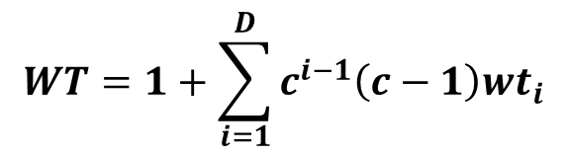

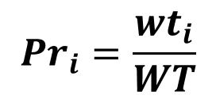
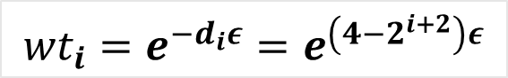
Privacy Mechanism Design
Key Point: Assign different projection weights to leaf nodes based on the distance to the exact node.
$${Pr}_{i}=\frac{wt_{i}}{WT}$$
The probability of a node
in $L_{i}$ being projected to
$${wt}_{i}=e^{−d_{i}ε}=e^{\left(4−2^{i+2}\right)ε}$$
$$WT=1+\sum_{i=1}^{D}{c^{i−1}\left(c−1\right)wt_{i}}$$
Total weight of
all leaf nodes
The projection
weight of a node in $L_{i}$
$L_{i}$: the set of leaf nodes whose LCA with the exact node is located at level $i$
Notes:
Finally, we can obtain the probability of a node being projected to based on the weight.
The probability is the ratio of its weight to the total weights of all leaf nodes

Slide 24
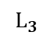
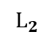
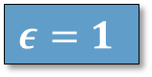

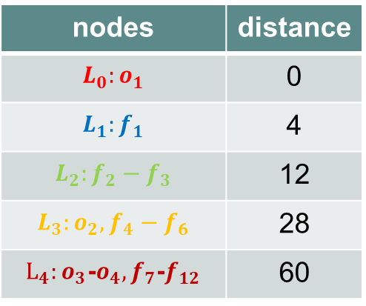
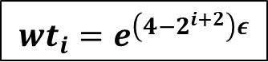
Privacy Mechanism Design
An Example
nodes | distance
$$L_{0}:o_{1}$$ | 0
$$L_{1}:f_{1}$$ | 4
$$L_{2}:f_{2}−f_{3}$$ | 12
$$L_{3}:o_{2},f_{4}−f_{6}$$ | 28
$L_{4}:o_{3}$-$o_{4},f_{7}$-$f_{12}$ | 60
weights
Prob
$$ε=1$$
$${wt}_{i}=e^{\left(4−2^{i+2}\right)ε}$$
$${Pr}_{i}=\frac{wt_{i}}{WT}$$
$$L_{1}$$
$$L_{3}$$
$$L_{4}$$
$$L_{1}$$
$$L_{2}$$
Notes:
Here is an example of our mechanism.
Firstly we divide all leaf nodes into L_i based on their distance to the exact node o_1
Then we calculate the weights of nodes in each L_i

Slide 25

Privacy Mechanism Design
An Example
$$e^{0}$$
nodes | distance
$$L_{0}:o_{1}$$ | 0
$$L_{1}:f_{1}$$ | 4
$$L_{2}:f_{2}−f_{3}$$ | 12
$$L_{3}:o_{2},f_{4}−f_{6}$$ | 28
$L_{4}:o_{3}$-$o_{4},f_{7}$-$f_{12}$ | 60
weights
1
Prob
$$ε=1$$
$${wt}_{i}=e^{\left(4−2^{i+2}\right)ε}$$
$${Pr}_{i}=\frac{wt_{i}}{WT}$$
$$L_{1}$$
$$L_{3}$$
$$L_{4}$$
$$L_{1}$$
$$L_{2}$$
Notes:
There is only one node o_1 in L_0, and its weight is zero power of e, that is one.

Slide 26

Privacy Mechanism Design
An Example
nodes | distance
$$L_{0}:o_{1}$$ | 0
$$L_{1}:f_{1}$$ | 4
$$L_{2}:f_{2}−f_{3}$$ | 12
$$L_{3}:o_{2},f_{4}−f_{6}$$ | 28
$L_{4}:o_{3}$-$o_{4},f_{7}$-$f_{12}$ | 60
weights
1
0.670
Prob
$$ε=1$$
$$e^{−4}$$
$${wt}_{i}=e^{\left(4−2^{i+2}\right)ε}$$
$${Pr}_{i}=\frac{wt_{i}}{WT}$$
$$L_{1}$$
$$L_{3}$$
$$L_{4}$$
$$L_{1}$$
$$L_{2}$$
Notes:
For f1 in L1, their weight is minus 4 power of e, because i=1 at this time.

Slide 27

Privacy Mechanism Design
An Example
nodes | distance
$$L_{0}:o_{1}$$ | 0
$$L_{1}:f_{1}$$ | 4
$$L_{2}:f_{2}−f_{3}$$ | 12
$$L_{3}:o_{2},f_{4}−f_{6}$$ | 28
$L_{4}:o_{3}$-$o_{4},f_{7}$-$f_{12}$ | 60
weights
1
0.670
0.301
Prob
$$ε=1$$
$$e^{−12}$$
$${wt}_{i}=e^{\left(4−2^{i+2}\right)ε}$$
$${Pr}_{i}=\frac{wt_{i}}{WT}$$
$$L_{1}$$
$$L_{3}$$
$$L_{4}$$
$$L_{1}$$
$$L_{2}$$
Notes:
Similarly we have the weights of nodes in L_3 and L_4

Slide 28

Privacy Mechanism Design
An Example
nodes | distance
$$L_{0}:o_{1}$$ | 0
$$L_{1}:f_{1}$$ | 4
$$L_{2}:f_{2}−f_{3}$$ | 12
$$L_{3}:o_{2},f_{4}−f_{6}$$ | 28
$L_{4}:o_{3}$-$o_{4},f_{7}$-$f_{12}$ | 60
weights
1
0.670
0.301
0.061
Prob
$$ε=1$$
$$e^{−28}$$
$${wt}_{i}=e^{\left(4−2^{i+2}\right)ε}$$
$${Pr}_{i}=\frac{wt_{i}}{WT}$$
$$L_{1}$$
$$L_{3}$$
$$L_{4}$$
$$L_{1}$$
$$L_{2}$$

Slide 29

Privacy Mechanism Design
An Example
nodes | distance
$$L_{0}:o_{1}$$ | 0
$$L_{1}:f_{1}$$ | 4
$$L_{2}:f_{2}−f_{3}$$ | 12
$$L_{3}:o_{2},f_{4}−f_{6}$$ | 28
$L_{4}:o_{3}$-$o_{4},f_{7}$-$f_{12}$ | 60
weights
1
0.670
0.301
0.061
0.002
Prob
$$ε=1$$
$$e^{−60}$$
$${wt}_{i}=e^{\left(4−2^{i+2}\right)ε}$$
$${Pr}_{i}=\frac{wt_{i}}{WT}$$
$$L_{1}$$
$$L_{3}$$
$$L_{4}$$
$$L_{1}$$
$$L_{2}$$

Slide 30
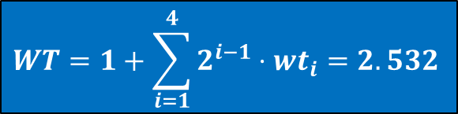
Privacy Mechanism Design
An Example
nodes | distance
$$L_{0}:o_{1}$$ | 0
$$L_{1}:f_{1}$$ | 4
$$L_{2}:f_{2}−f_{3}$$ | 12
$$L_{3}:o_{2},f_{4}−f_{6}$$ | 28
$L_{4}:o_{3}$-$o_{4},f_{7}$-$f_{12}$ | 60
weights
1
0.670
0.301
0.061
0.002
Prob
0.394
0.264
0.119
0.024
0.001
$$ε=1$$
$$WT=1+\sum_{i=1}^{4}{2^{i−1}⋅wt_{i}}=2.532$$
$${wt}_{i}=e^{\left(4−2^{i+2}\right)ε}$$
$${Pr}_{i}=\frac{wt_{i}}{WT}$$
$$L_{1}$$
$$L_{3}$$
$$L_{4}$$
$$L_{1}$$
$$L_{2}$$
Notes:
After calculate all weights, the total weight of all leaf nodes is 2.532.
And the probability of a node being the obfuscated node can also be calculated, as shown in the last column of the table.

Slide 31
Privacy Mechanism Design
An Example
nodes | distance
$$L_{0}:o_{1}$$ | 0
$$L_{1}:f_{1}$$ | 4
$$L_{2}:f_{2}−f_{3}$$ | 12
$$L_{3}:o_{2},f_{4}−f_{6}$$ | 28
$L_{4}:o_{3}$-$o_{4},f_{7}$-$f_{12}$ | 60
weights
1
0.670
0.301
0.061
0.002
Prob
0.394
0.264
0.119
0.024
0.001
$$ε=1$$
$${wt}_{i}=e^{\left(4−2^{i+2}\right)ε}$$
$${Pr}_{i}=\frac{wt_{i}}{WT}$$
$$L_{1}$$
$$L_{3}$$
$$L_{4}$$
$$L_{1}$$
$$L_{2}$$
Notes:
And this is the probability produced by our privacy mechanism

Slide 32
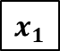
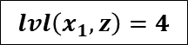
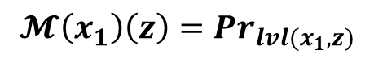
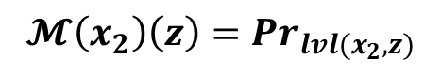

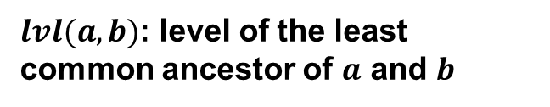
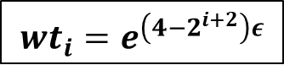
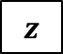
Privacy Mechanism Design
Proof of Geo-Indistinguishability
$${wt}_{i}=e^{\left(4−2^{i+2}\right)ε}$$
$${Pr}_{i}=\frac{wt_{i}}{WT}$$
$lvl(a,b)$: level of the least common ancestor of $a$ and $b$
$$lvl\left(x_{1},z\right)=4$$
Level 4
$$𝓜\left(x_{1}\right)\left(z\right)={Pr}_{lvl(x_{1},z)}$$
Level 3
Level 2
$$𝓜\left(x_{2}\right)\left(z\right)={Pr}_{lvl(x_{2},z)}$$
Level 1
Level 0
$$x_{1}$$
$$z$$
Notes:
We also prove that our mechanism satisfies the geo-indistinguishability.

Slide 33
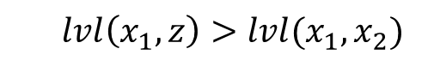
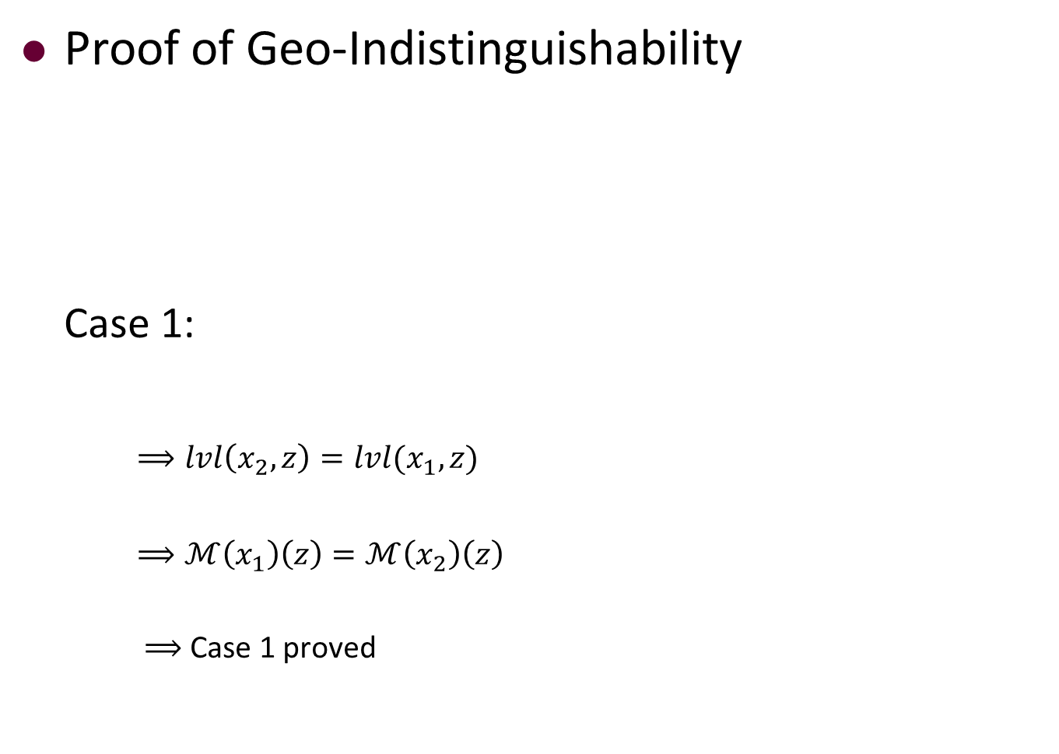

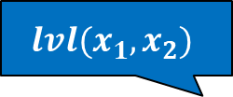
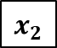
Privacy Mechanism Design
Proof of Geo-Indistinguishability
Case 1:
$⟹lvl\left(x_{2},z\right)=lvl(x_{1},z)$
$⟹ℳ\left(x_{1}\right)\left(z\right)=ℳ\left(x_{2}\right)\left(z\right)$
$⟹$ Case 1 proved
$${wt}_{i}=e^{\left(4−2^{i+2}\right)ε}$$
$${Pr}_{i}=\frac{wt_{i}}{WT}$$
$$lvl(x_{1},z)$$
$$lvl\left(x_{1},z\right)>lvl(x_{1},x_{2})$$
$$lvl(x_{1},x_{2})$$
$$x_{1}$$
$$x_{2}$$
$$z$$
Notes:
The key point is to prove the geo-I in two cases:
In the first case, the node z is outside the subtree of x1 and x2

Slide 34
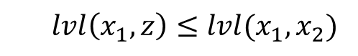
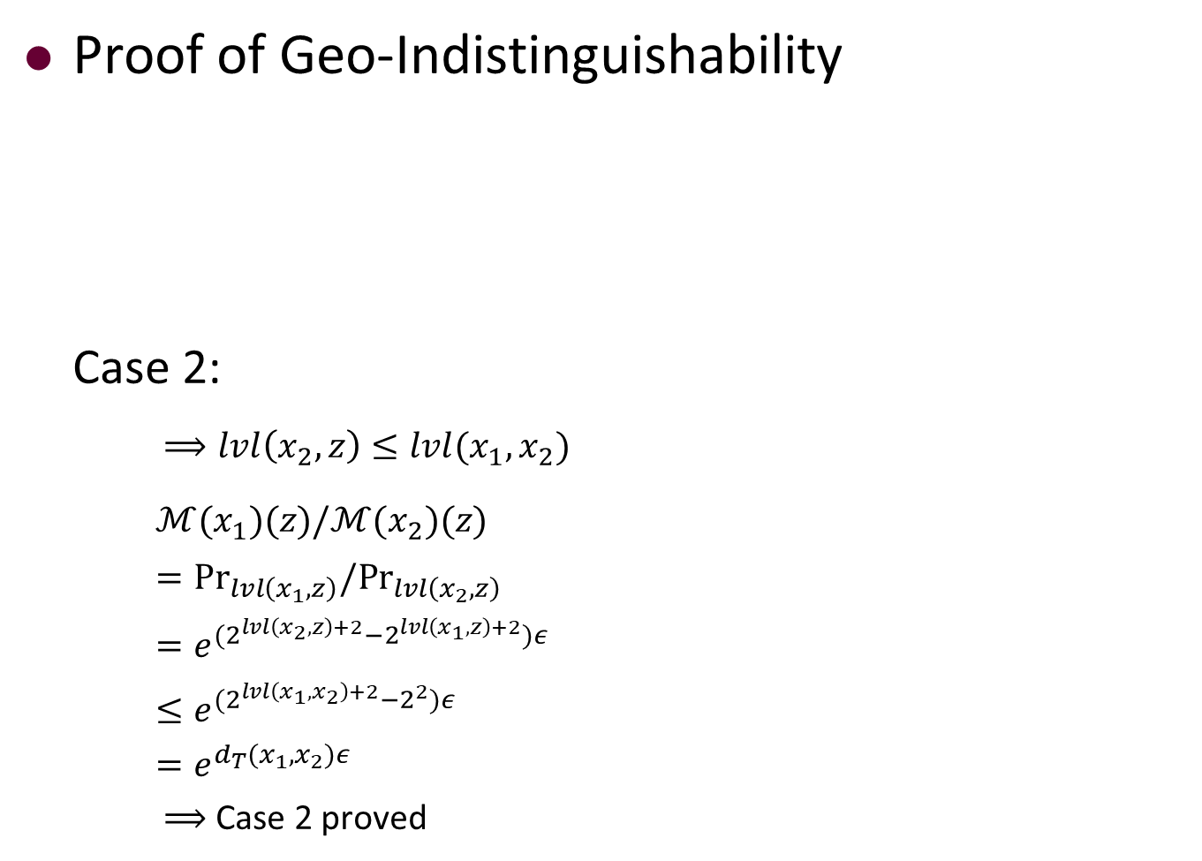




Privacy Mechanism Design
Proof of Geo-Indistinguishability
Case 2:
$⟹lvl\left(x_{2},z\right)≤lvl(x_{1},x_{2})$
$ℳ(x_{1})(z)/ℳ(x_{2})(z)$
$={Pr}_{lvl\left(x_{1},z\right)}/{Pr}_{lvl\left(x_{2},z\right)}$
$=e^{(2^{lvl\left(x_{2},z\right)+2}−2^{lvl\left(x_{1},z\right)+2})ε}$
$≤e^{(2^{lvl\left(x_{1},x_{2}\right)+2}−2^{2})ε}$
$=e^{d_{T}(x_{1},x_{2})ε}$
$⟹$ Case 2 proved
$${wt}_{i}=e^{\left(4−2^{i+2}\right)ε}$$
$${Pr}_{i}=\frac{wt_{i}}{WT}$$
$$lvl(x_{1},x_{2})$$
$$lvl\left(x_{1},z\right)≤lvl(x_{1},x_{2})$$
$$lvl(x_{1},z)$$
$$x_{1}$$
$$z$$
$$x_{2}$$
Notes:
And in the second case, one of the exact node, say x2, is outside the subtree of x1 and z.
We skip the proof due limited time.
Details can be found in our paper.

Slide 35
Tree-based Framework
Our solution is devised based on a tree-based framework.
Server
①Construct and publish the HST
②Add noise by our mechanism
③Publish the obfuscated locations
④Assign tasks/workers
①
①
④
④
③
③
②
Task
Worker
②
Perturbed Task
Perturbed
Worker
Notes:
In the last step, the server needs to make task assignment for tasks and workers.

Slide 36
Task Assignment
Main Idea: Devise a greedy algorithm on the HST.
Server
①Construct and publish the HST
②Add noise by our mechanism
③Publish the obfuscated locations
④Assign tasks/workers
①
①
④
④
③
③
②
Task
Worker
②
Perturbed Task
Perturbed
Worker
Notes:
We devise a greedy algorithm on the HST, because as will be shown later, our framework enables the greedy algorithm effective.

Slide 37





Task Assignment
Analysis of HST-based Greedy:
The competitive ratio of the Tree-based Framework can be bounded by
$$\frac{M_{TBF}}{M_{OPT}}=O(\frac{1}{ε^{4}}⋅\log{N}\log^{2}{k})$$
The Matching with server
unknowing truth locations
$N:$ Number of truth nodes in HST
$k:$ Number of tasks /workers
$ε:$ Privacy budget
The Optimal Matching even
knowing all truth locations
The competitive ratio of HST-Greedy
without privacy
An extra product related
to privacy budget $ε$
Notes:
We prove that the competitive ratio of our tree-based framework can be bounded by the following equation.
Comparing with the hst-based greedy algorithm with no privacy requirement, our work has an extra product only related to the privacy budget \epsilon

Slide 38
Outline
Background and Motivation
Problem Definition
A Tree-based Framework
Random Walk Acceleration
Experimental Evaluation
Conclusions
Notes:
We further propose a random walk optimization to accelerate the mechanism.

Slide 39





Privacy Mechanism Revisited
It takes $O(c^{D})$ to enumerate the probability of all leaf nodes.
$c:$ Number of branches of the HST
$D:$ Levels of the HST
Server
①Construct and publish the HST
②Add noise by our mechanism
③Publish the obfucated locations
④Assign tasks/workers
①
①
④
nodes | distance | weights | Prob
$$o_{1}$$ | 0 | 1 | 0.394
$$f_{1}$$ | 4 | 0.670 | 0.264
$$f_{2}−f_{3}$$ | 12 | 0.301 | 0.119
$$o_{2},f_{4}−f_{6}$$ | 28 | 0.061 | 0.024
$o_{3}$-$o_{4},f_{7}$-$f_{12}$ | 60 | 0.002 | 0.001
④
$c^{D−1}$ leaf nodes in total
③
③
②
Task
②
Worker
Perturbed Task
Question:
How to accelerate the mechanism?
Perturbed
Worker
Notes:
In our framework it takes c^D time to enumerate the probability of all leaf nodes, which is time-consuming.
Hence a question is how to accelerate the mechanism?

Slide 40





A Random Walk Acceleration
Main Idea:
Start from the exact node and randomly walk up or down with some probability at each node
Repeat until another leaf node is reached
$$pu_{4}=0$$
$$pu_{3}=0.075$$
$$pu_{2}=0.304$$
$$pu_{1}=0.564$$
$$pu_{0}=0.606$$
Notes:
Our main idea is as follows:
We start from the exact node and then randomly walk up or down with some probability at each node.
The action repeats until we reach another leaf node as the obfuscated node.

Slide 41











A Random Walk Acceleration
Algorithm Details:
Phase I: Walk up until obtain a tail from the coin (at level $k$) with its head probability
$pu_{k}=\frac{tw_{k+1}}{tw_{k}}$
$$tw_{k}=\left\{\begin{aligned}\sum_{i≥k}^{D}{c^{i−1}(c−1)wt_{i}}, if k>0 \\ w_{0}+\sum_{i=1}^{D}{c^{i−1}\left(c−1\right)wt_{i}}, if k=0\end{aligned}\right.$$
$$pu_{4}=0$$
$$pu_{3}=0.075$$
$$pu_{2}=0.304$$
$$pu_{1}=0.564$$
The total weights of leaf
nodes outside level $k$
(including level $k$)
$$pu_{0}=0.606$$
$${tw}_{4}$$
$${tw}_{3}$$
Notes:
In details, our algorithm includes two phases.
In the first phase, we walk up from the exact node and at level k go on walking up with probability pu_k as shown in the slides, where the variable tw_k represents the total weights of all leaf nodes outside level k

Slide 42

A Random Walk Acceleration
Algorithm Details:
Phase I: Walk up until obtain a tail from the coin (at level $k$) with its head probability
$pu_{k}=\frac{tw_{k+1}}{tw_{k}}$
$$tw_{k}=\left\{\begin{aligned}\sum_{i≥k}^{D}{c^{i−1}(c−1)wt_{i}}, if k>0 \\ w_{0}+\sum_{i=1}^{D}{c^{i−1}\left(c−1\right)wt_{i}}, if k=0\end{aligned}\right.$$
$$pu_{4}=0$$
$$pu_{3}=0.075$$
$$pu_{2}=0.304$$
$$pu_{1}=0.564$$
The total weights of leaf
nodes outside level $k$
(including level $k$)
$$pu_{0}=0.606$$
$${tw}_{4}$$
$${tw}_{3}$$

Slide 43
A Random Walk Acceleration
Algorithm Details:
Phase I: Walk up until obtain a tail from the coin (at level $k$) with its head probability
$pu_{k}=\frac{tw_{k+1}}{tw_{k}}$
$$tw_{k}=\left\{\begin{aligned}\sum_{i≥k}^{D}{c^{i−1}(c−1)wt_{i}}, if k>0 \\ w_{0}+\sum_{i=1}^{D}{c^{i−1}\left(c−1\right)wt_{i}}, if k=0\end{aligned}\right.$$
$$pu_{4}=0$$
$$pu_{3}=0.075$$
$$pu_{2}=0.304$$
$$pu_{1}=0.564$$
The total weights of leaf
nodes outside level $k$
(including level $k$)
$$pu_{0}=0.606$$
$${tw}_{4}$$
$${tw}_{3}$$

Slide 44

A Random Walk Acceleration
Algorithm Details:
Phase II: Walk down uniformly (except the subtree that has been passed) until reaching a leaf node
$$pu_{4}=0$$
$$pu_{3}=0.075$$
$$pu_{2}=0.304$$
$$pu_{1}=0.564$$
$$pu_{0}=0.606$$
Passed subtree
Subtree being walked down
Notes:
Once obtaining a tail, we turn to phase 2 to walk down uniformly until reaching a leaf node.
Note that we no longer walk through the subtree that has been passed.
Hence the left substree will be passed, and we directly walk down to the right subtree

Slide 45

A Random Walk Acceleration
Algorithm Details:
Phase II: Walk down uniformly (except the subtree that has been passed) until reaching a leaf node
$$pu_{4}=0$$
$$pu_{3}=0.075$$
$$pu_{2}=0.304$$
Each child node being
chosen with probability $\frac{1}{c}$
$$pu_{1}=0.564$$
$$pu_{0}=0.606$$
Notes:
Once we enter the right subtree, at each level child nodes will be chosen uniformly, that is, each child node will be chosen with a probability 1 on c,

Slide 46

A Random Walk Acceleration
Algorithm Details:
Phase II: Walk down uniformly (except the subtree that has been passed) until reaching a leaf node
$$pu_{4}=0$$
$$pu_{3}=0.075$$
$$pu_{2}=0.304$$
Each child node being
chosen with probability $\frac{1}{c}$
$$pu_{1}=0.564$$
$$pu_{0}=0.606$$

Slide 47

A Random Walk Acceleration
Algorithm Details:
Phase II: Walk down uniformly (except the subtree that has been passed) until reaching a leaf node
$$pu_{4}=0$$
$$pu_{3}=0.075$$
$$pu_{2}=0.304$$
$$pu_{1}=0.564$$
Each child node being
chosen with probability $\frac{1}{c}$
$$pu_{0}=0.606$$
Notes:
As the figure shows, f_6 is finally chosen as the obfuscated node.

Slide 48


A Random Walk Acceleration
Time Complexity:
Phase I: Walk up until obtain a tail from the coin (at level $k$) with its head probability
Phase II: Walk down uniformly (except the subtree that has been passed) until reaching a leaf node
$$pu_{4}=0$$
Each level is passed at
most $2$ times: $O(D)$
$$pu_{3}=0.075$$
$$pu_{2}=0.304$$
$$pu_{1}=0.564$$
$$pu_{0}=0.606$$
Notes:
Since our algorithm passes each level at most 2 times, the total time complexity of the random walk acceleration is O(D)

Slide 49

Tree-based Framework
Design a tree-based
privacy mechanism
Show the efficiency of the HST-
Greedy under our framework
An accelerated implementation
of the mechanism

Slide 50
Outline
Background and Motivation
Problem Definition
A Tree-based Framework
Random Walk Acceleration
Experimental Evaluation
Conclusions
Notes:
In the fifth part, we show the experimental evaluation.

Slide 51
Experimental Settings
Compared Algorithms:
TBF:
Our tree-based framework + the random walk acceleration
Lap-GR:
Laplacian Mechanism + The Greedy Algorithm
LAP-HG:
Laplacian Mechanism + The HST-Greedy Algorithm
State-of-the-art mechanism
for location privacy
Representative task assignment algo-
rithms with minimum total distance
Notes:
We compare two baselines with our framework.
Both of them are based on the state-of-the-art mechanism for location privacy,Laplacian mechanism.

Slide 52


Experimental Settings
Datasets:
Synthetic datasets: 200x200 Euclidean space
Real datasets:
Trip records of passengers from Didi Chuxing
Parameters for Normal distribution
Notes:
We conduct experiments on both synthetic datasets and real datasets.

Slide 53


Experimental Results
Results on synthetic datasets
Results on seal datasets
Our framework
Our framework
Notes:
These are part of our experimental results.
We can observe that our framework can get a lower total distance under different parameters.

Slide 54


Experimental Results: Synthetic datasets
Total distance
Time and memory cost
Our framework
Our framework
Our framework
Our framework
Notes:
These are part of our experimental results.
We can observe that our framework can get a lower total distance compared with the baselines, and

Slide 55


Experimental Results: Real datasets
Total distance
Time and memory cost
Our framework
Our framework

Slide 56
Outline
Background
Problem Definition
A Tree-based Framework
Random Walk Acceleration
Experimental Evaluation
Conclusions

Slide 57
Contributions
Devise a novel tree-based framework for private online task assignment
Design a privacy mechanism to protect location privacy
analyze the effectiveness of the framework
Propose a random walk method for acceleration
Notes:
In conclusion, our work contains the following four contributions:
We …

Slide 58

Notes:
That’s all, thank you

